Slide 1
2. Tokens, Control Structures

Slide 2
Tokens
The smallest individual units in a program are known as tokens.
Keywords
Identifiers
Constants
Operators
Strings

Slide 3
Keywords
They are explicitly reserved identifiers and cannot be used as names for the program variables or other user-defined program elements.

Slide 4
keyword
asm else operator throw
auto enum private true
bool explicit protected try
break extern public typedef
case false register typeid
catch float reinterpret_cast typename
char for return union
class friend short unsigned
const goto signed using
const_cast if sizeof virtual
continue inline static void
default int static_cast volatile
delete long struct wchar_t
do mutable switch while
double namespace template
dynamic_cast new this

Slide 5
Identifiers
An identifiers is made of one or more characters
The first character must be a letter or an underscore. All following characters can be letters, numbers or underscores
No limit on the length of a variable’s name.
Names starting with an underscore or with a double underscore are normally reserved to system use!
C++ is case sensitive!
const int Entries;
double _attempts;
double 2A; // error!

Slide 6
Predefined types in C++
All numeric types to represent integer numbers, real numbers and character variables are predefined

Slide 7
Name | Description | Size* | Range*
char | Character or small integer. | 1byte | signed: -128 to 127 unsigned: 0 to 255
short int (short) | Short Integer. | 2bytes | signed: -32768 to 32767 unsigned: 0 to 65535
int | Integer. | 4bytes | signed: -2147483648 to 2147483647 unsigned: 0 to 4294967295
long int (long) | Long integer. | 4bytes | signed: -2147483648 to 2147483647 unsigned: 0 to 4294967295
bool | Boolean value. It can take one of two values: true or false. | 1byte | true or false
float | Floating point number. | 4bytes | +/- 3.4e +/- 38 (~7 digits)
double | Double precision floating point number. | 8bytes | +/- 1.7e +/- 308 (~15 digits)
long double | Long double precision floating point number. | 8bytes | +/- 1.7e +/- 308 (~15 digits)

Slide 8
Predefined types in C++
Literal constant
Constant character
123 O123 0x123 constant integers,
decimal, octal,
hexadecimal
123l 123u integers, long,
unsigned
‘A’ ‘1’ ‘\t’ character, tab
3.14f 3.1415 3.1415L float, double,
long double
300e-2 .03e2 30e-1 double, scientific notation
“Name” constant string
true false boolean
‘\a’ alert
‘\\’ backslash
‘\b’ backspace
‘\r’ carriage return
‘\”’ double quote
‘\f’ form feed
‘\t’ tab
‘\n’ newline
‘\0’ null character
‘\’’ single quote
‘\v’ vertical tab
‘\101’ 101 octal, ‘A’
‘\x041’ hexadecimal, ‘A’
String constant
“” null string (‘\0’)
“name” ‘n’ ‘a’ ‘m’ ‘e’ ‘\0’
“a \”string\”” prints: a “string”
“a string \ a \ at the end of the line
spanning two lines” to continue on the next line

Slide 9
Declaration of Variables
A declaration associates a meaning to an identifier
In C++ all entities must be declared before they can be used
A declaration is (often) a definition as well. For simple variables this means assigning a value to the variable, when the latter is declared
const int i=100; // the i variable
double max(double r1,double r2); // the max function
const double pi=3.1415926; // definition
double max(double r1, double r2) { // declaration
return (r1>r2) ? r1: r2; // definition of max
}

Slide 10
Scope
Variables can be declared and defined (almost) everywhere in a C++ program
A variable’s visibility (scope) depends on where a variable has been declared
int func()
{
…
const int n=50; // function scope
for (int i=0;i<100;i++) // local i
{
double r; // local r
...
}
cout<<“n “<< n <<endl; // OK
cout<<“i “<< i <<endl; // error!
cout<<“r “<< r <<endl; // error! No doubt
…
}

Slide 11
Scope (2)
Beware! The same variable can be re-declared several time (with different scope). Don’t do that (if possible), this makes your program hard to follow and error prone!
int i; // file (global) scope
int func()
{
int i=50; // function scope, hides
// i at file scope
for (int i=0;i<100;i++) // block scope. Hides
// i at function scope
{
int i; // this is an error...
...
}
cout<<“i “<< i <<“ “<< ::i <<endl;
...
}
Scope resolution operator

Slide 12
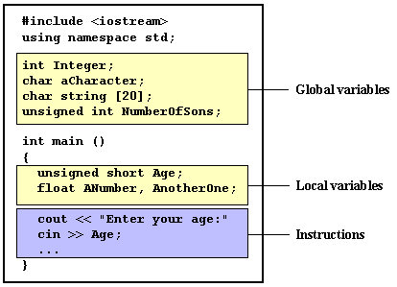
Scope(3)

Slide 13
Symbolic Constants
The keyword const is used for declaring a constant variable
In C, people used the preprocessor to declare the constants
in this case, N is a constant with no type, the preprocessor will just substitute N with its value everywhere throughout the program, without respecting the strong typing rules (avoid)
a const variable must be initialized on creation
const int N=100; N cannot be modified
double w[N]; N is used here to declare
a vector
const int vect[5]= vect’s components cannot be {10,20,30,40,50}; modified
Example for const
#define N 100

Slide 14


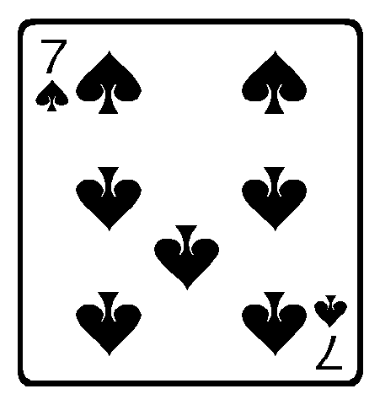
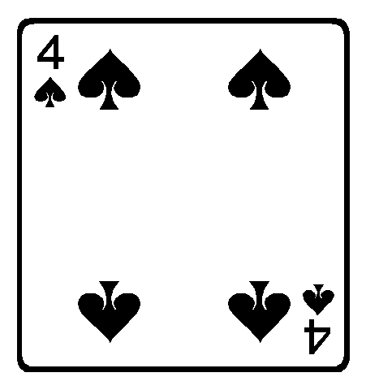

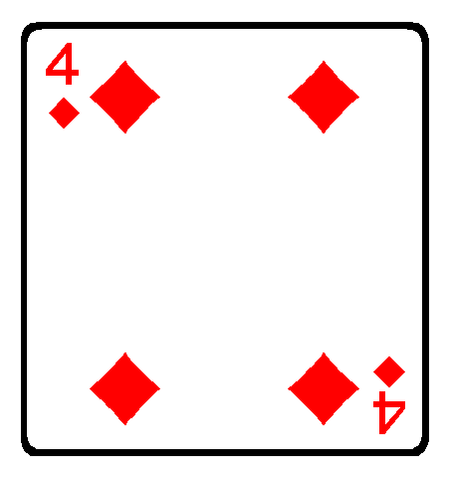
Enumerated Data Types
Enum is the simplest form of user defined type in C++
enum Color { red, green, blue }; Color screenColor = blue; Color windorColor = red; int n = blue; // OK Color c = 1; // error!
enum Cards
{ Hearts, Spades, Diamonds, Clubs };

Slide 15
Operators
Arithmetic operators ( +, -, *, /, % )
The five arithmetical operations supported by the C++ language are:
+ | addition
- | subtraction
* | multiplication
/ | division
% | modulo

Slide 16
Operators
Compound assignment (+=, -=, *=, /=, %=, >>=, <<=, &=, ^=, |=)
expression | is equivalent to
value += increase; | value = value + increase;
a -= 5; | a = a - 5;
a /= b; | a = a / b;
price *= units + 1; | price = price * (units + 1);

Slide 17
Operators
Increase and decrease (++, --)
Example 1 | Example 2
B=3; A=++B; // A contains 4, B contains 4 | B=3; A=B++ // A contains 3, B contains 4

Slide 18
Operators
Relational and equality operators ( ==, !=, >, <, >=, <= )
== | Equal to
!= | Not equal to
> | Greater than
< | Less than
>= | Greater than or equal to
<= | Less than or equal to

Slide 19
Operators
Logical operators ( !, &&, || )
&& OPERATOR
|| OPERATOR
a | b | a && b
true | true | true
true | false | false
false | true | false
false | false | false
a | b | a || b
true | true | true
true | false | true
false | true | true
false | false | false

Slide 20
Operators
Conditional operator ( ? )
condition ? result1 : result2
7==5 ? 4 : 3 // returns 3, since 7 is not equal to 5.
7==5+2 ? 4 : 3 // returns 4, since 7 is equal to 5+2.
5>3 ? a : b // returns the value of a, since 5 is greater than 3.
a>b ? a : b // returns whichever is greater, a or b.

Slide 21
Operators
Bitwise Operators ( &, |, ^, ~, <<, >> )
operator | description
& | Bitwise AND
| | Bitwise Inclusive OR
^ | Bitwise Exclusive OR
~ | Unary complement (bit inversion)
<< | Shift Left
>> | Shift Right

Slide 22
Operators
Explicit type casting operator
Type casting operators allow you to convert a data of a given type to another. There are several ways to do this in C++. The simplest one, which has been inherited from the C language, is to precede the expression to be converted by the new type enclosed between parentheses (()):
int i;
float f = 3.14;
i = (int) f;

Slide 23
Operators
sizeof()
This operator accepts one parameter, which can be either a type or a variable itself and returns the size in bytes of that type or object:
a = sizeof (char);

Slide 24
Statements
Statement C++ comments
empty ;
expression j=j+k;
composite { . . . . } used in functions,if.. Costitutes a block
goto goto label; don’t use it!
if if (p==0)
cerr<<“error”; single branch
if-else if (x==y)
cout<<“the same”;
else
cout<<“different”; two branches
for for (j=0;j<n;j++) declarations allowed
a[j]=0;
while while (i != j) 0 or more iterations
i++;
do-while do
y=y-1; 1 or more iterations
while (y>0);
break break; leaves the block
continue continue; next iteration

Slide 25
Statements
Statement C++ comments
switch switch (s) {
case 1: use break not to fall
++i; in te following case
case 2: add a default case at
--i; the end of the case default: list
++j; };
declaration int i=7; in a block, file or
namespace
return return x*x*x; return value of a
function

Slide 26
Composite statements
A composite statement is made of a series of statements between {}
Normally used for grouping statements is a block (if, for, while, do-while, etc.)
A function body is always made of a composite statement
A variable declaration can be put anywhere in a block. In this case, the variable scope will be the block itself

Slide 27
strings
The C++ language library provides support for strings through the standard string class. This is not a fundamental type, but it behaves in a similar way as fundamental types do in its most basic usage
A first difference with fundamental data types is that in order to declare and use objects (variables) of this type we need to include an additional header file in our source code: <string> and have access to the std namespace

Slide 28
strings
// my first string
#include <iostream>
#include <string>
using namespace std;
int main (){
string mystring = "This is a string";
cout << mystring;
return 0;
}

